Slide 1
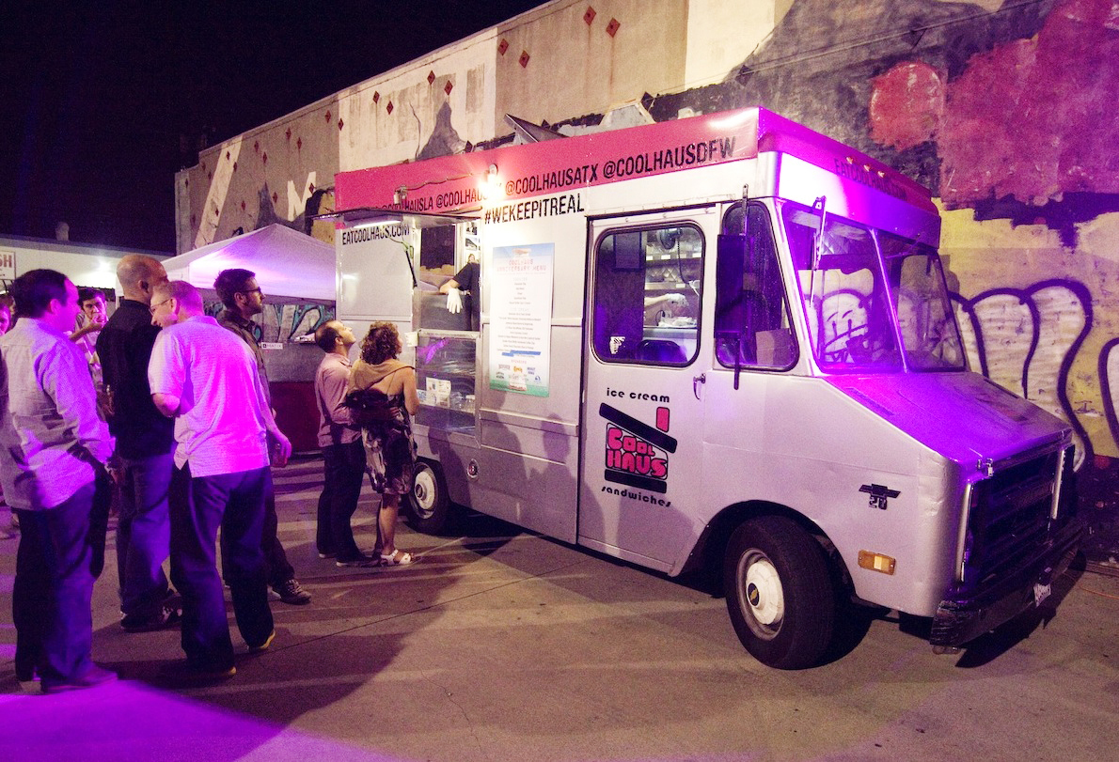
Truck Chasers
Brazil Group
Regel Selmani - Minoj Khadgi
Mengistu Tadesse – Gralyn Stokes

Slide 2

Project description
Truck Chasers is a free app created to be a more efficient tool for locating and promoting mobile truck businesses in the DC Metro area. All mobile businesses are welcome, from food trucks, animal groomers, car detailers and cleaning services.
Customers can register to gather information and locate their favorite mobile truck businesses in real time.
Truck owners register to the app to have the ability to display important information about their business, including menus, services, as well as pictures. Truck Chasers also gives truck owners the ability to give customers their location 24/7 in real time.

Slide 3
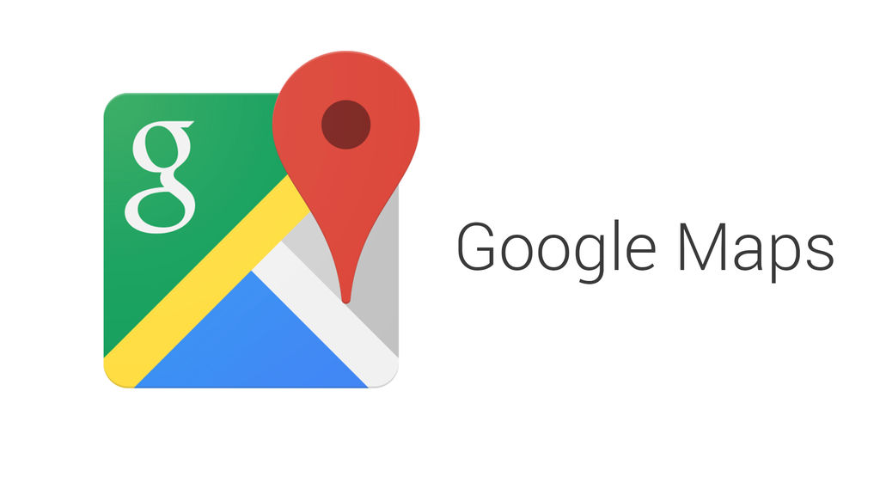
API’s used
CHALLENGES
Coordinating the changes between group members and merging updates without erasing each others work.
Pushing and pulling information on Github.

Slide 4
Workload
Regel Selmani
Minoj Khadgi
HTML
CSS
javascript
Mysql
sequelize
Node
API
Gralyn Stokes
Mengistu Tadesse
HTML
CSS
PowerPoint
javascript
Mysql
sequelize
node

